Slide 1
Taking a Close Look at Mothers and Pirates
Mary Cassatt, Howard Pyle, and NC Wyeth

Slide 2
Attention: Startling stat, anecdote, quote
Need: What do I want my students to know? What hasn’t been drawn out?
Satisfaction: What strategies will I use to draw it out?
Vision: What are my exercises for my students?
Action: What am I going to do, read, talk with my team, have a dialog with fellows.

Slide 3
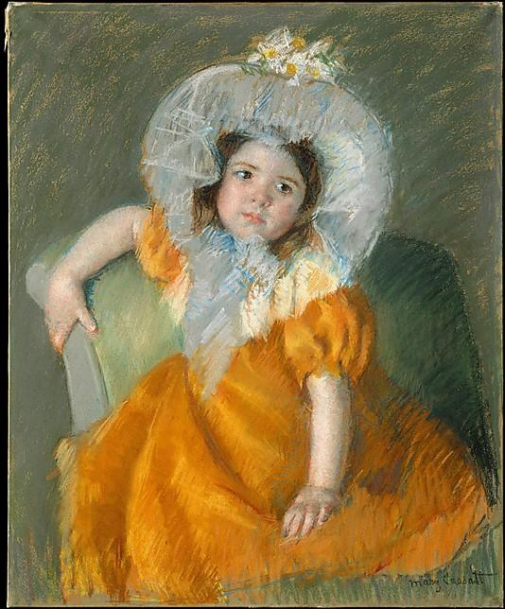
Mary Cassatt
Margo in an Orange Dress

Slide 4
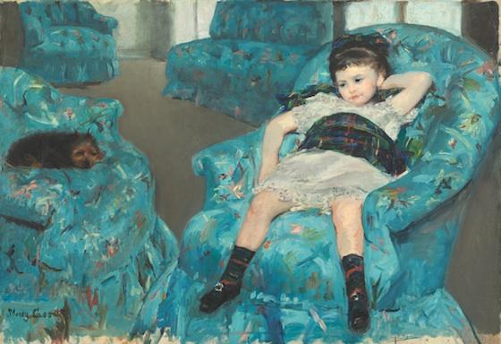
Mary Cassatt, 1878,
Little Girl in a Blue Armchair

Slide 5
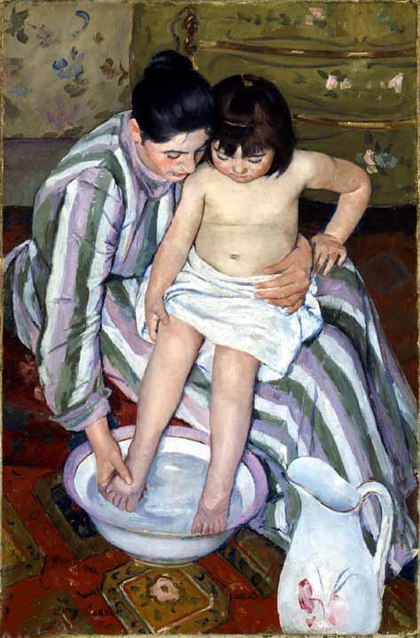
Mary Cassatt
1893,
The Child’s Bath

Slide 6
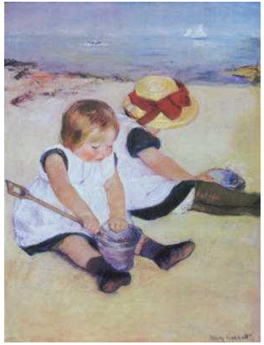
Mary Cassatt 1884
Children Playing on the Beach

Slide 7
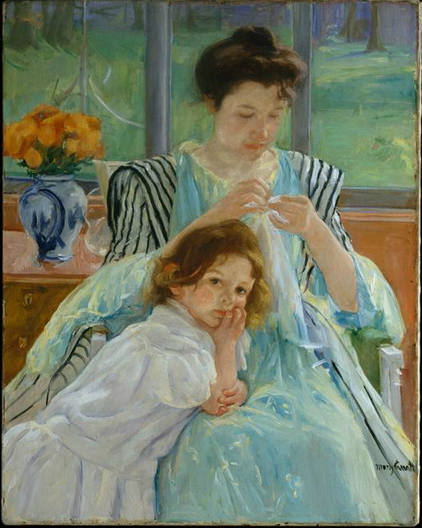
Mary Cassatt, 1900
Young Mother Sewing

Slide 8
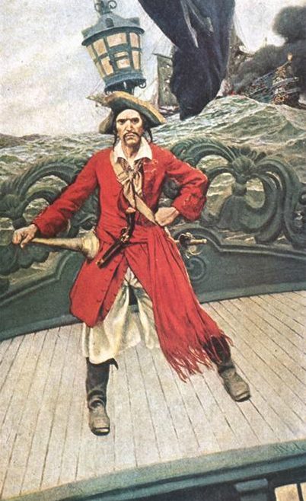
Howard Pyle, 1907
Captain Keitt

Slide 9
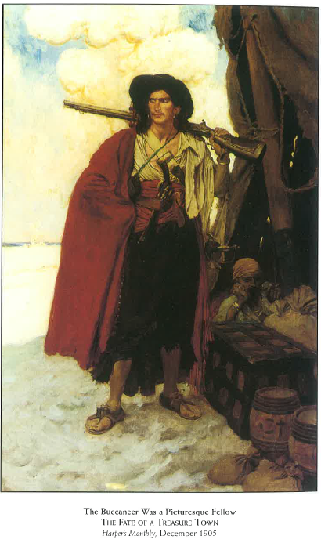
Howard Pyle, 1905,
The Buccaneer Was a
Picturesque Fellow

Slide 10
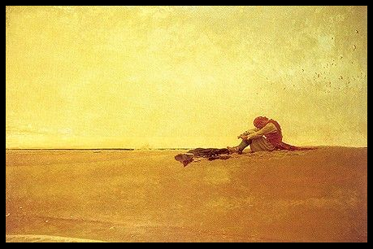
Howard Pyle, 1909
Marooned

Slide 11
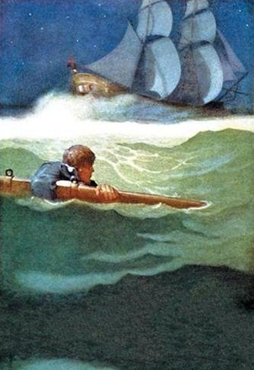
NC Wyeth,
1913
The Wreck of the “Covenant”
Kidnapped

Slide 12
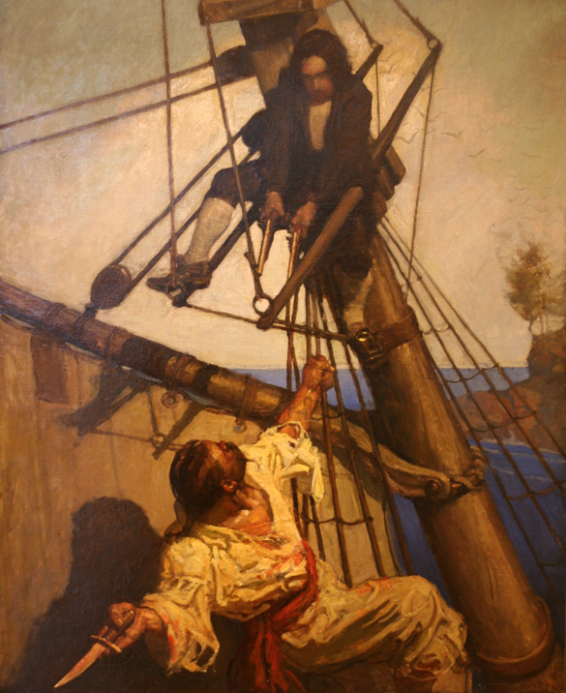
Howard Pyle,
1911
“One more step, Mr. Hands,” said I, “and I’ll blow your brains out.” Treasure Island

Slide 13
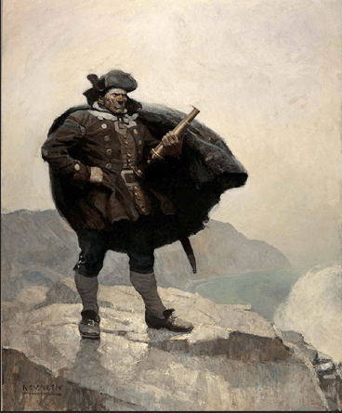
Howard Pyle, 1911
All day he hung round the cove, or upon the cliffs, with a brass telescope. Treasure Island

